Slide 1
Streamline Health® eValuator™
Pro Fee Superuser Training

Slide 2
Training Overview
Training Overview
eValuator™ Overview​
Requires Further Review
eValuator™ Rules​
Automated Pre-bill Analysis Workflow​
eValuator Trivia
Test Cases in UAT
Q&A
Learning Objectives
At the end of this training, you should be able to:​
  Define the purpose of eValuator​
  Describe the value of automated pre-bill analysis​
  Recognize the significance of the likelihood of CPT or ICD-10 error
  Explain the Auditing and Coder workflow​
  Audit an encounter in eValuator, including​
    Logging in to eValuator​
    Reviewing advice and other information
    Entering comments​
    Completing the Auditor stage and Coder Stage
  Explain the E/M Calculator Workflow.
    Describe Medical Decision Making (MDM) and Time data entry in the E/M Calculator.
Notes:
During this training we will discuss the following:
We will define the purpose of eValuator and describe the value of the automated pre-bill analysis.
We will show you how to recognize the significance of the likelihood of CPT or ICD-10 error.
We will explain the auditor and the coder workflows.
And finally we will audit an encounter in eValuator. Including logging into eValuator, reviewing the eValuator advice and other information, entering comments and completing both the auditor and coder stages.

Slide 3
What does eValuator offer?
5,000+ Proprietary Rules
Easy Implementation
Automated Routing
Narrative Advice
Real-Time Insights
Robust rulesets developed from decades of auditing insight thoroughly analyze each case prior to billing to gauge for coding accuracy and compliant revenue capture
Cloud-based eValuator is easily implemented and maintained. it integrates with existing EHR, encoder and billing systems to minimize disruption and deliver fast ROI.
Using custom thresholds, it automatically gauges cases and routes to the designated resource to ensure your team is always focused on the highest impact opportunities.
Flagged charts are returned in real time with detailed corrections on suspected issues, helping assure accuracy while improving coder performance over the long term.
Dashboards display real-time KPIs to monitor ongoing performance, while robust reporting offers summaries with drill-down capabilities for more actionable insights.
Notes:
A brief overview of the offerings of eValuator
eValuator has over 5000 proprietary rules that contain detailed narrative advice that will aid in identifying suspected coding issues. eValuator is easy to implement, has automated routing and provides dashboards and reporting to help monitor performance and provide actionable insights.

Slide 4
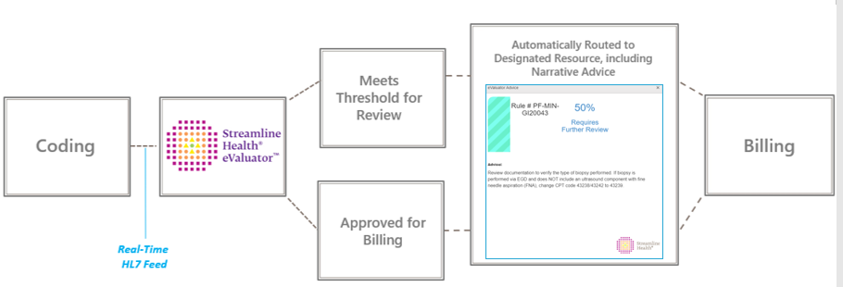
eValuator Overview
Training Overview
eValuator™ Overview​
Requires Further Review
eValuator™ Rules​
Automated Pre-bill Analysis Workflow​
eValuator Trivia
Test Cases in UAT​
Q&A
Where does eValuator fit into your workflow?
Between coding and billing
Notes:
eValuator exists between coding and billing.
All data flowing into eValutor comes from your coding solution. It will be sent through the eValuator rules engine. If the encounter does not hit a rule, it will be sent directly on to billing. If an encounter does hit a rule, based on what your threshold is set at, the encounter will either be moved into a workpool for review or will be sent on to billing. When auditing encounters in eValuator, if a needed coding change is discovered, the code change will always need to be made in your coding system

Slide 5
Requires Further Review - What gets held and what doesn’t?
Training Overview
eValuator Overview
Requires Further Review
eValuator Rules
Automated Pre-bill Analysis Workflow
eValuator Trivia
Test Cases in UAT
Q&A
100% certainty of error ​
  ICD-10 burn code reported with a non-burn debridement code
90% certainty of error ​
  99202 has been reported with 2 or more chronic conditions
70% certainty of error ​
  CPT codes for specimen validity billed with drug screening CPT codes
50% certainty of error​
  Modifier 59 appended to code 11720 when billed with 11055
10% certainty of error​
  Introduction of anesthetic agents by injection vs. indwelling catheter
THRESHOLD
Notes:
Requires further review or RFR is a percentage assigned to all rules that relates to the likelihood of a coding error. So for example an ICD-10 code for a burn that is reported with a non-burn debridement code has a higher likelihood of error than a CPT code that was reported for introduction of anesthetic agents by injection that could have been introduced through an indwelling catheter for continuous infusion.
The threshold that you set will determine which encounters are held up for billing. For example, if your threshold is set at 70%, then any encounter that hits a rule with an RFR of 70 or above will be moved to a work pool and held from billing. Encounters that hit a rule with an RFR below 70% would be sent straight to billing.

Slide 6
EValuator Rules
5,000+ Total Rules​
Sample Rule
Rules Development
Created by auditing experts each with decades of experience
Leveraged data from more than 1.25 million audited cases
Implementing machine-learning framework to pressure-test validity scores and take into account claims-based information
Rules Editor
Custom Thresholds:
Customizable Validity Impact Score
Customizable Notification Pop-up Thresholds
Rule Detail: Rule #PF-MIN-MUSC20020– Incorrect Procedure
Procedure code 20612 has been billed with a diagnosis other than M67.4*
Likelihood of CPT Error: 90%​
Narrative Advice:​
  eValuator data analysis indicates that CPT code 20612 was reported without an ICD-10 code for a ganglion cyst. Review the documentation to determine the type of injection performed. For injection of a tendon sheath or ligament, see 20550. For arthrocentesis, aspiration, and/or injection of a small joint or bursa, see 20600–20604; intermediate joint or bursa, see 20605–20606. For aspiration and injection of a bone cyst, see 20615.
Notes:
eValuator’s 5000 plus rules have been developed by auditing experts with decades of experience. Data from more than 1.25 million audited cases has been leveraged in creation of the rules and rules narratives. Streamline is also implementing machine-learning to pressure-test requires further review scores and to take into account claims-based information.
A sample rule is seen on the slide. In this example, eValuator would identify an encounter with the procedure code for aspiration or injection of a ganglion cyst that has not been reported with a diagnosis code for ganglion cyst. The narrative explains the reason for the potential error and gives the auditor advice on how to proceed.

Slide 7
The Auditor and Coder Workflows

Slide 8
Workflow Overview
Training Overview
eValuator™ Overview​
Requires Further Review
eValuator™ Rules​
Automated Pre-bill Analysis Workflow​
eValuator Trivia
Test Cases in UAT​
Q&A
In the following slides we'll discuss​:
  Auditor releasing an encounter to Billing (No Change)​
  Auditor making recommendations to the Coder (Complete)​
  Coder Accepting Recommendations​
  Coder Disagreeing with Recommendations
Notes:
In the upcoming slides we will go through the following processes:
An auditor reviewing an encounter that does not need a change and releasing that encounter to billing using the No Change button
An auditor reviewing an encounter and making recommendations to the coder using the Complete button
A coder accepting the recommendations from the auditor
A coder disagreeing with the recommendations from the auditor

Slide 9
Workflow Overview
Training Overview
eValuator™ Overview​
Requires Further Review
eValuator™ Rules​
Automated Pre-bill Analysis Workflow​
eValuator Trivia
Test Cases in UAT​
Q&A
Logging In
Test Environment:​
  This is where you go to practice and play with test data
  https://uat-evaluator.streamlinehealth.net/
Prod Environment:​
  This is where you will primarily work from once we Go-Live
  https://evaluator.streamlinehealth.net/
Notes:
This slide contains the URLs for the test and production environments in eValuator. The test environment is where you would go to practice using eValuator and play with the test data. The production environment is where you will primarily work once we Go-Live

Slide 10
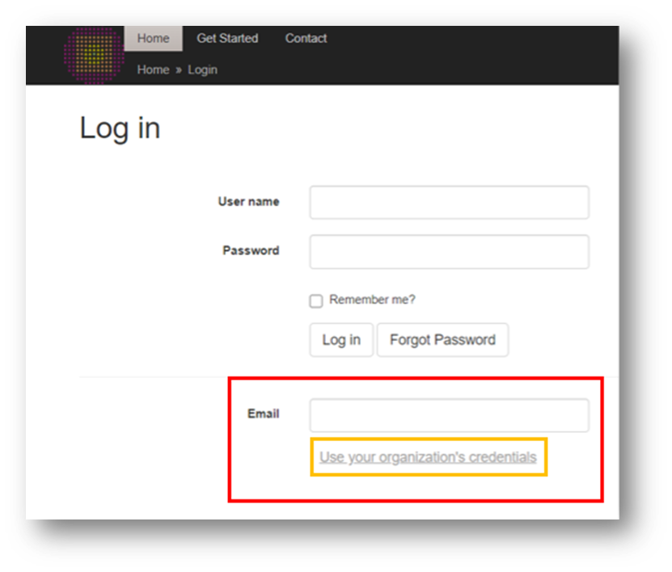
Workflow Overview
Training Overview
eValuator™ Overview​
Requires Further Review
eValuator™ Rules​
Automated Pre-bill Analysis Workflow​
eValuator Trivia
Test Cases in UAT​
Q&A
Logging In
Enter your email in the Email box.​
In Production, select 'Use your organization's credentials'
Notes:
To log into eValuator, in production, you will use single sign on. You will type in your e-mail and then select "Use your organizations credentials". You will be taken to your organization's sign in page and will automatically be logged in based on your network credentials.

Slide 11
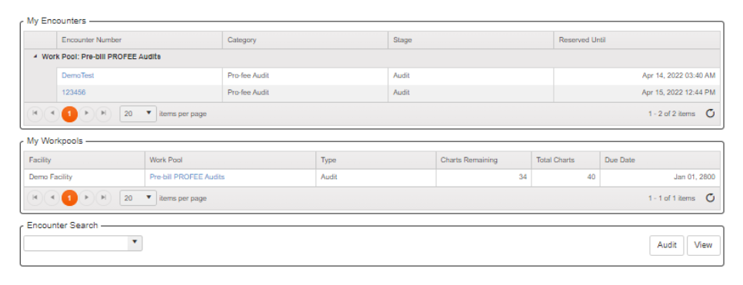
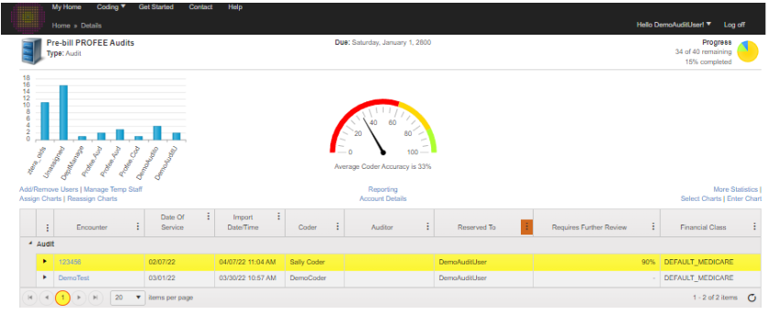
Auditor Workflow – Your Home Screen
My Workpools
  Workpool Detail
    Encounters
Notes:
On your Home Screen will contain all the workpools that you have available for selection.
If you click on the work pool, you will open the Workpool Detail screen. This view displays all of the encounters within the work pool.

Slide 12
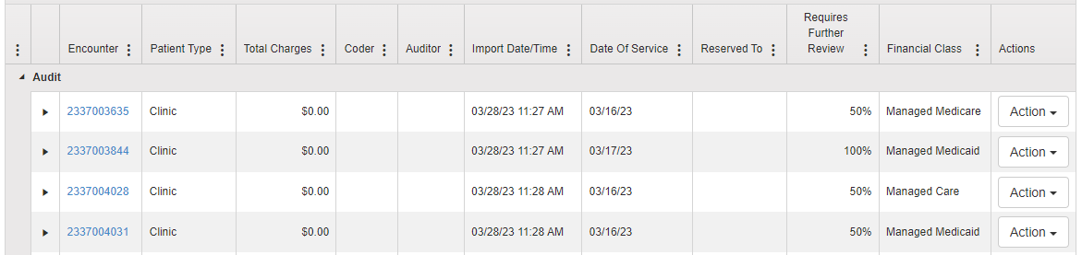
Auditor Workflow
The Workpool Detail screen
Within each Workpool, encounters can be worked by clicking on the encounter number
Each column header can be sorted by clicking on the column name
Each column can also be filtered by clicking on the ellipses (…) on each header to filter your results
Notes:
Within each work pool, encounters can be worked by clicking on the encounter number. Each column can be sorted by clicking on the column names. The columns can also be filtered by clicking on the ellipses on each header.
You will also have the ability to save any filter or sort in order to customize your work pool view.
You can click on any encounter number and it will open the Audit Details page

Slide 13
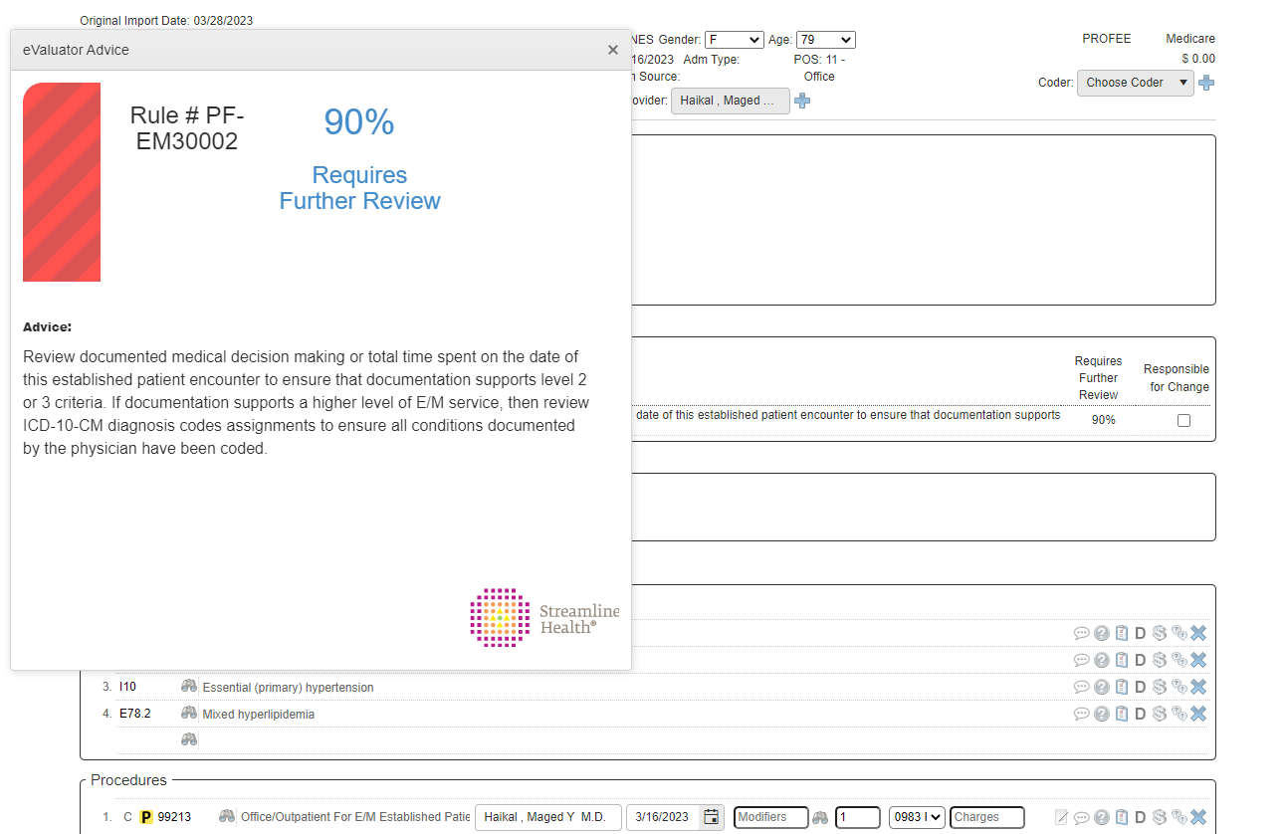
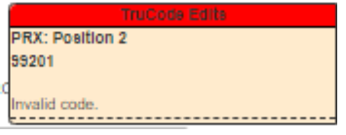
Auditor Workflow
eValuator Advice/Audit Detail Screen
If a rule that has been triggered exceeds the threshold, the eValuator Advice Window displays.​
It shows the rule, the Likelihood of Change, and the recommended action
If applicable, a TruCode Edits window will appear in the upper right portion of the screen
Notes:
Once you click into an encounter, the eValuator Advice Window will display. This window contains information related to the name of the rule that fired, the requires further review percentage (likelihood of error) and the advice narrative. The advice should be carefully reviewed before closing the window as this advice contains the recommended action to take regarding the review of the codes on the encounter.
It is important to note that the rules will not result in a change in coding 100% of the time. They are meant to be guidance. The narrative advice will help guide you in the right direction and explain why the encounter was held from billing.
If applicable, a TruCode Edits window will appear in the upper right portion of the screen. These edits should be reviewed for any needed updates to the encounter. Please note though, the TruCode edits are not related to the eValuator rules. There are for additional information only.

Slide 14
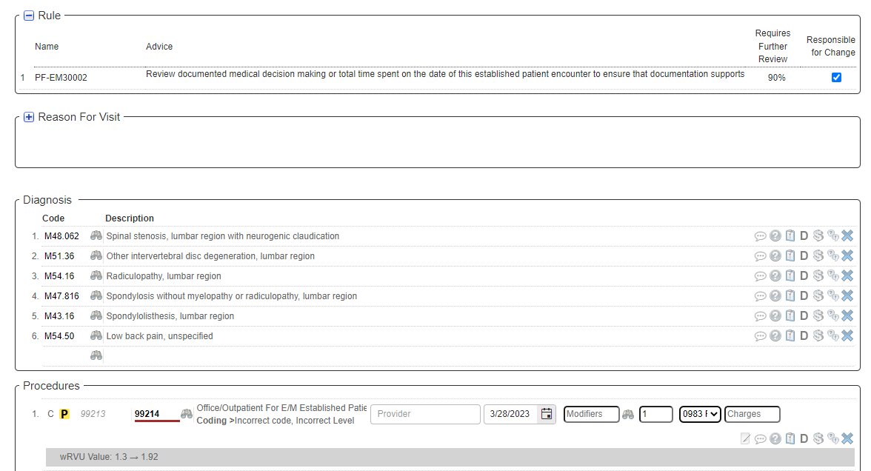
Auditor Workflow
Audit Detail Screen
After reviewing the Rule and the CPT and ICD-10 code sections, as appropriate, consider following the Advice.​
In this example, review the chart to verify documentation for a higher level of E/M service.
If evidence is found, correct the E/M code in the Procedures section
Notes:
Once the rule and rule advice has been reviewed, you will review the diagnosis and procedure code sections, as appropriate based on the rule advice. In this example, the rule advice indicates that the E/M code may be undercoded. The chart will be reviewed for documentation to support any correction of the E/M code. If the support is found, then the code would be corrected in the procedure section.
As a side note, there is an E/M calculator that is built in eValuator that will assist in auditing E/M services. We will be discussing the calculator later in this presentation.

Slide 15
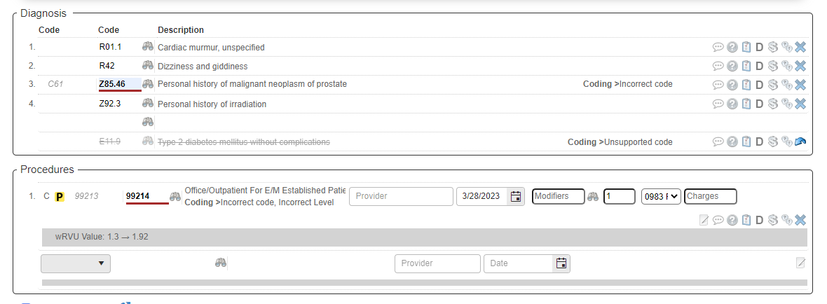
Auditor Workflow
Audit Detail Screen
You can make any changes or re-sequence codes as needed.
The encounter can always be reset if necessary, using the Reset button on the Tool Bar
Notes:
Any changes that are necessary can be made on the Audit Detail Screen. Codes can be added, changed or resequenced, as appropriate.
The encounter can always be reset if necessary, using the Reset button on the tool bar at the bottom of the screen.

Slide 16
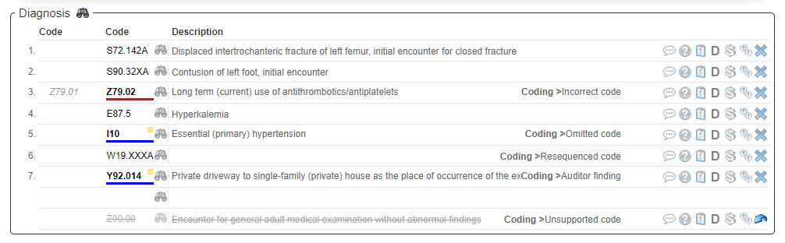
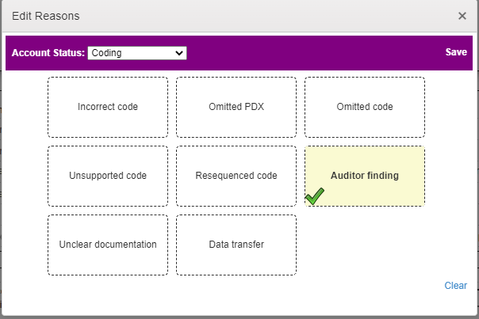
Auditor Workflow
Code Change Reasons
Code Change Reason of Auditor Finding– Does not count against the Accuracy statistics
Notes:
When a coding change is made, a code change reason is assigned.
If a code is changed, the change reason will be incorrect code. If one is added, the change reason will be omitted code. If a code is resequenced, that reason will be resequenced code. And if a code is removed, the change reason will be unsupported code. Reporting can be done on all of the change reason codes.
One thing to keep in mind, if a code is incorrect and needs to be changed. For example, on this slide, Z79.01 was incorrect and the correct code is Z79.02. If you would remove Z79.01 and then add Z79.02, that would count as two errors – one unsupported and one omitted code. If you change the Z79.01 to Z79.02, then there would just be one error logged as Incorrect code.
If the auditor does not want the code change to count against the coder or provider. The auditor can click on the code change reason and select Auditor Finding. The coding change would then not count against the accuracy statistics.

Slide 17


Auditor Workflow
Validate and Enter Comments
When you have completed your audit of the encounter, open up the Comments box (Right)
  Note: Comments may be made to the
  procedure, diagnosis item, or at the
  encounter level.
Notes:
Once the audit is completed for the encounter, click on the Comments button at the bottom of the Audit Detail Screen. A comments box will open up. Comments for the Coder related to any changes recommended should be entered here. Comments can also be made at the procedure or diagnosis level using the comments bubble on each of those line items. The comment will then be specifically associated with that line item in the Encounter Notes section.

Slide 18


Auditor Workflow
Example of Detailed Comments
Notes:
An example of different types of comments can be seen on the slide.
The top comment was entered using the comment bubble on the diagnosis line. You can see how this comment is associated specifically with diagnosis code F32.1. This method of entering comments is beneficial when there are multiple changes made to an encounter.
The bottom comment was entered using the Comments button at the bottom of the screen.

Slide 19
Auditor Workflow
Completing the Encounter
If everything looks fine AS IS and there are no recommendations, click [1] No Change. This will release the encounter to billing.
OR
If you're making recommendations, click [C]omplete. This moves the encounter to the Coder stage and the encounter will continue to be held from billing.
Notes:
If the auditor has no recommendation and would like to release the encounter to billing, then No Change should be clicked.
If the auditor has recommendations and would like to move the encounter to the coder stage, then Complete should be clicked. Clicking on complete will not only move the encounter to the coder stage, but it will also continue to hold the encounter from billing.
In summary, No Change moves the encounter to billing and Complete moves the encounter to coder stage.

Slide 20
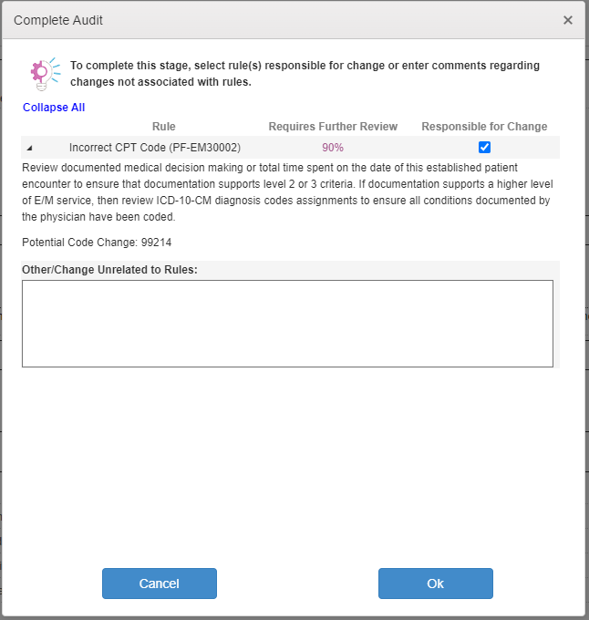
Auditor Workflow
Rule Responsibility
When the Auditor completes an encounter, they will assign the rule responsible for the coding change
  In many cases this will be pre-selected if the code change is directly related to the rule
  Some encounters will hit multiple rules and only one rule will apply
Other/Change Unrelated to Rules
  Use this box when change is not related to any rules that fired on encounter
Selecting the appropriate rule that is responsible for the coding change or identifying the reason for change not related to a rule will provide insight to Streamline and help create additional rule-based value
Notes:
Once the auditor has completed the encounter, a rule responsibility box will open. The auditor will assign the rule responsible for the coding change.
Some encounters hit multiple rules and only one rule may apply. Selecting the appropriate rule that is responsible for coding change is important as it will provide insight to Streamline to help create additional rule-based value.
If the coding change was NOT due to any rule that fired on the encounter, then a brief note on why the change was made should be entered into the Other/Change Unrelated to Rules box. This information will help Streamline identify additional rule opportunities.
Feedback given within this box is reviewed on a regular basis and is extremely important in aiding Streamline to make sure we are providing the most value to your organization through our rules

Slide 21
Auditor Workflow
Audit Toolbar – What does each button do?
F4 sandbox mode/safe zone – Make temporary changes.
eValuator Advice – Provides Rule guidance and how potential changes could impact reimbursement.
Reset – Returns the encounter to the original stage.
*No change – No changes to make, coding is correct. Sends encounter to billing.
CM/RAC issue - Used for tracking RAC focus/targets.
Comments – Shows all comments and allows editing or new comments to be entered (including disposition comments).
Revise Origin - Use if you need to add or change anything to the original coded information; not for audit changes.
Draft – Use this option to save your work if you cannot finish an account.
*Complete - Mark the encounter as complete after revisions. Sends the encounter to Coder Stage. Use No Change for accounts that are correctly coded.
Cancel – Allows you to leave or exit the encounter.
Notes:
This slide details each button on the audit toolbar and what they are used for.
I will again highlight No Change and Complete.
No Change is to be used when there are no changes on the encounter and it should be released to billing.
Complete is to be used when there is a change recommended on the encounter needs to be sent to Coder stage for review.

Slide 22
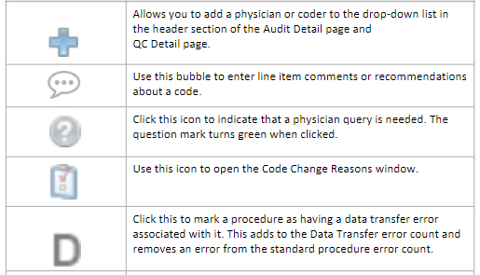
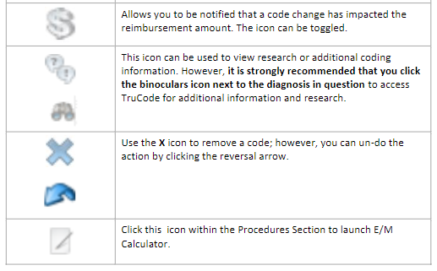
Auditor Workflow
eValuator Icons – What does each icon mean?
Notes:
This slide gives the detail regarding the icons that are seen within the eValuator Audit Details Page

Slide 23
The Coder Workflow

Slide 24
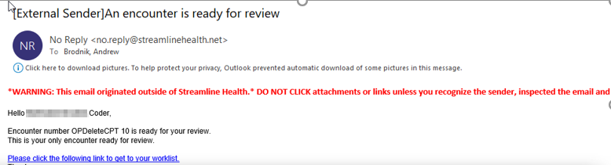
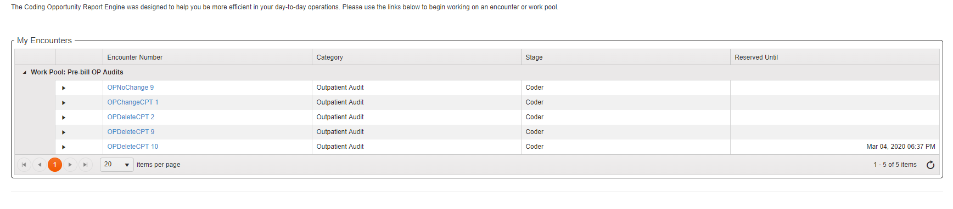
Coder Workflow
Home Screen
You can access your home screen through the links received in your emails (which take you directly to your encounter)
Or by simply logging in and being presented with the following screen:
Notes:
If an auditor recommends a change on an encounter, they will complete the encounter and it will be sent to the Coder Stage in eValuator. St. Luke’s has batch e-mails set up. So, one e-mail per day will go out to the coders to alert them to any encounters that have been sent to them.
The coder can click on the hyperlink in the email and will be taken directly to the encounter.
The coder can also log into eValuator at any time during the day and they will be taken to the Coder Home Screen that will show any encounters that require their review.

Slide 25
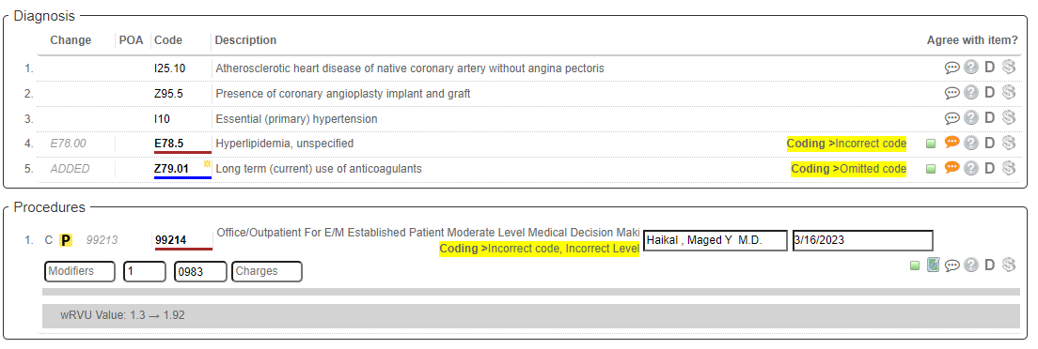
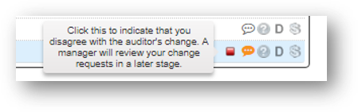
Coder Workflow
Responding to an Encounter
Yellow notes bubble indicates an auditor comment specific to that line item
The encounter opens and shows any changes that have been made by the Auditor
If you disagree with a recommendation, click the Green Box of the code change and turn it Red
Notes:
Once the coder clicks on the encounter, they will be able to see any changes that were made by the auditor and any notes that the auditor added. Recommendations will be highlighted in yellow. Any notes specific to a line item will be indicated by a yellow notes bubble. If the auditor used the E/M calculator, there will be a green paper and pen icon beside the E/M code. The notes bubble and pen and paper icon can be clicked to review the details.
If the coder disagrees with the auditor, the coder will click the Green box on the line of the recommended change. Once the box is clicked, it will turn red.

Slide 26


Coder Workflow
The Coder’s Decision
When you disagree and turn the box red, you will see the following toolbar:
If you agree with the audit (leaving the green box as is), you will see the following tool bar:
Notes:
If the coder disagrees, and the green box is clicked to turn it red. The tool bar, as seen on the slide will appear.
The coder will click Response Notes and add a note for the auditor regarding why they disagree with the change. The coder will then click Send to Audit.
If the coder agrees with the audit, then the second toolbar on the slide, will be seen.
The coder will make the coding changes in the coding system and will then click Accept Audit.

Slide 27
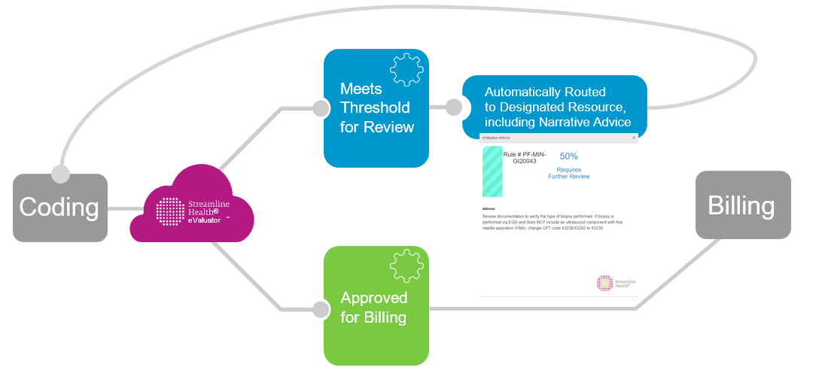
Coder Workflow
eValuator Pre-Bill Coding Analysis Flow
If you, a coder, Accept an Audit you must update the code in your coding system because eValuator lives between Coding and Billing
Notes:
This slide again details the workflow of eValuator's pre-bill analysis. Because eValuator lives between Coding and Billing, it is very important that if there is a change to coding that is identified in the eValuator auditing process, that the coder update the code or codes in their coding system.

Slide 28
E/M Calculator

Slide 29

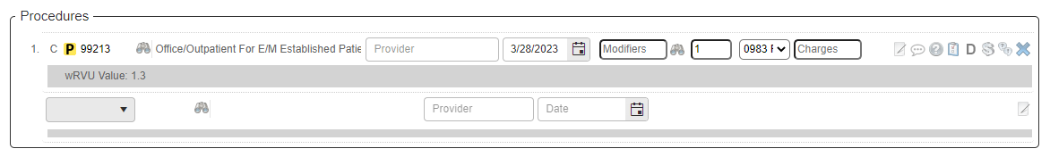

E/M Calculator
eValuator has an E/M calculator built in to assist with auditing E/M services
  To launch the E/M calculator, click on the icon to the right of the E/M code
    The E/M calculator icon only displays on E/M procedures within the Audit Details page
Notes:
An E&M Calculator is built into eValuator can be used for any E/M code that has been reported. The calculator can be launched by selecting the icon to the right of the procedure line item. The E/M calculator icon only displays on E/M procedures within the Profee Audit Details page.

Slide 30
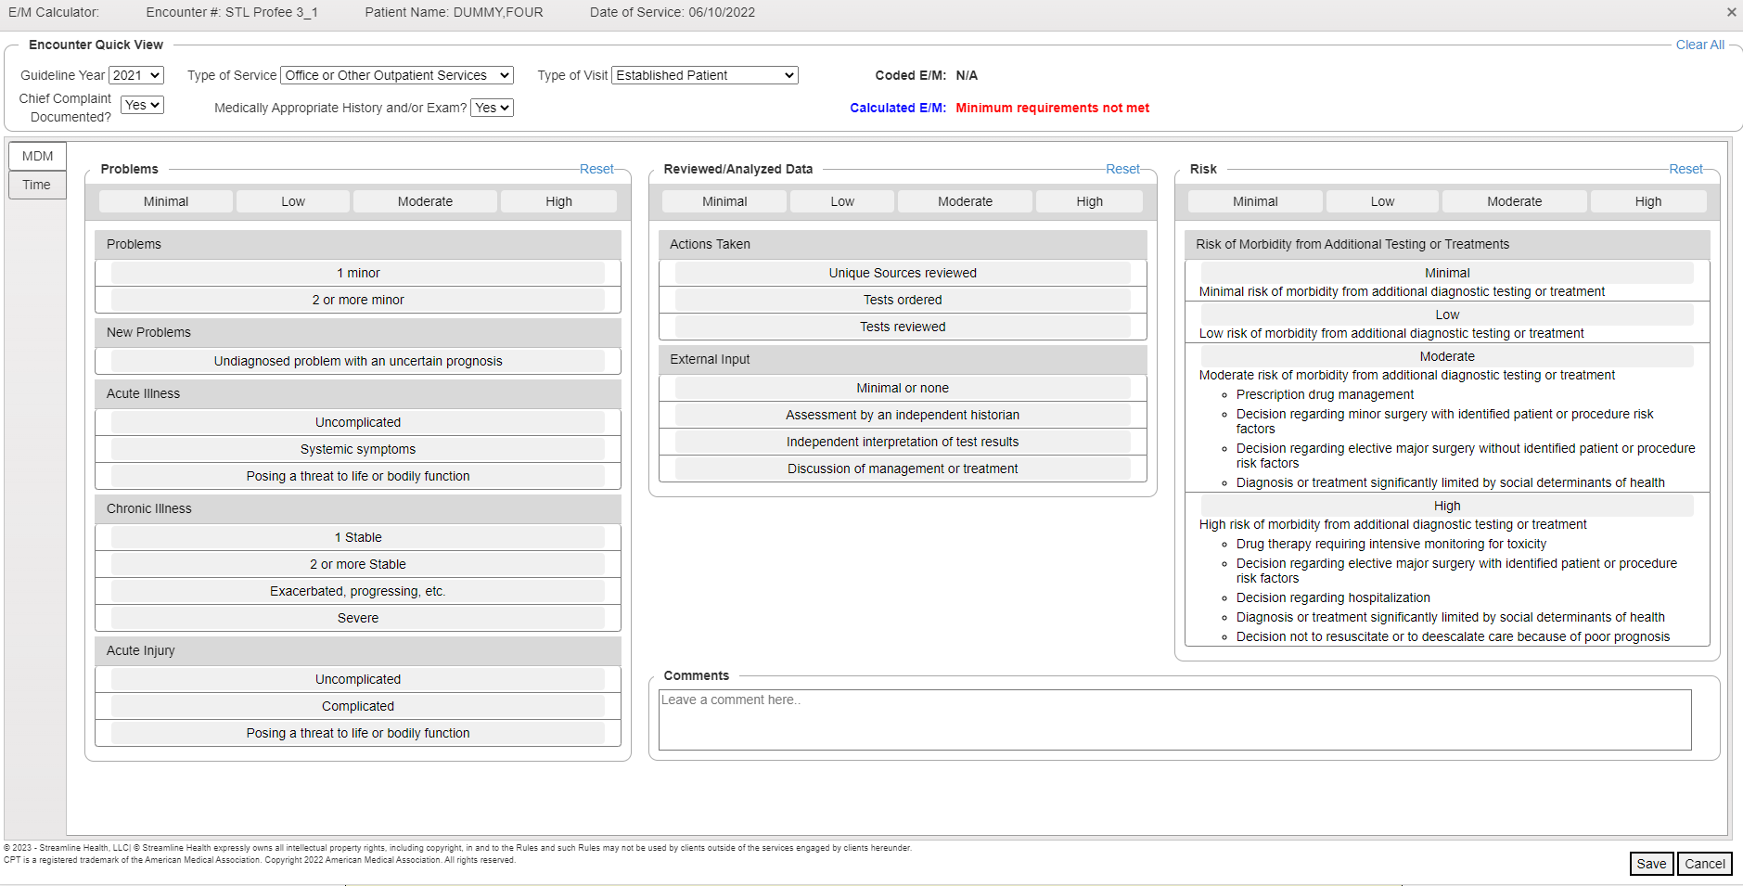
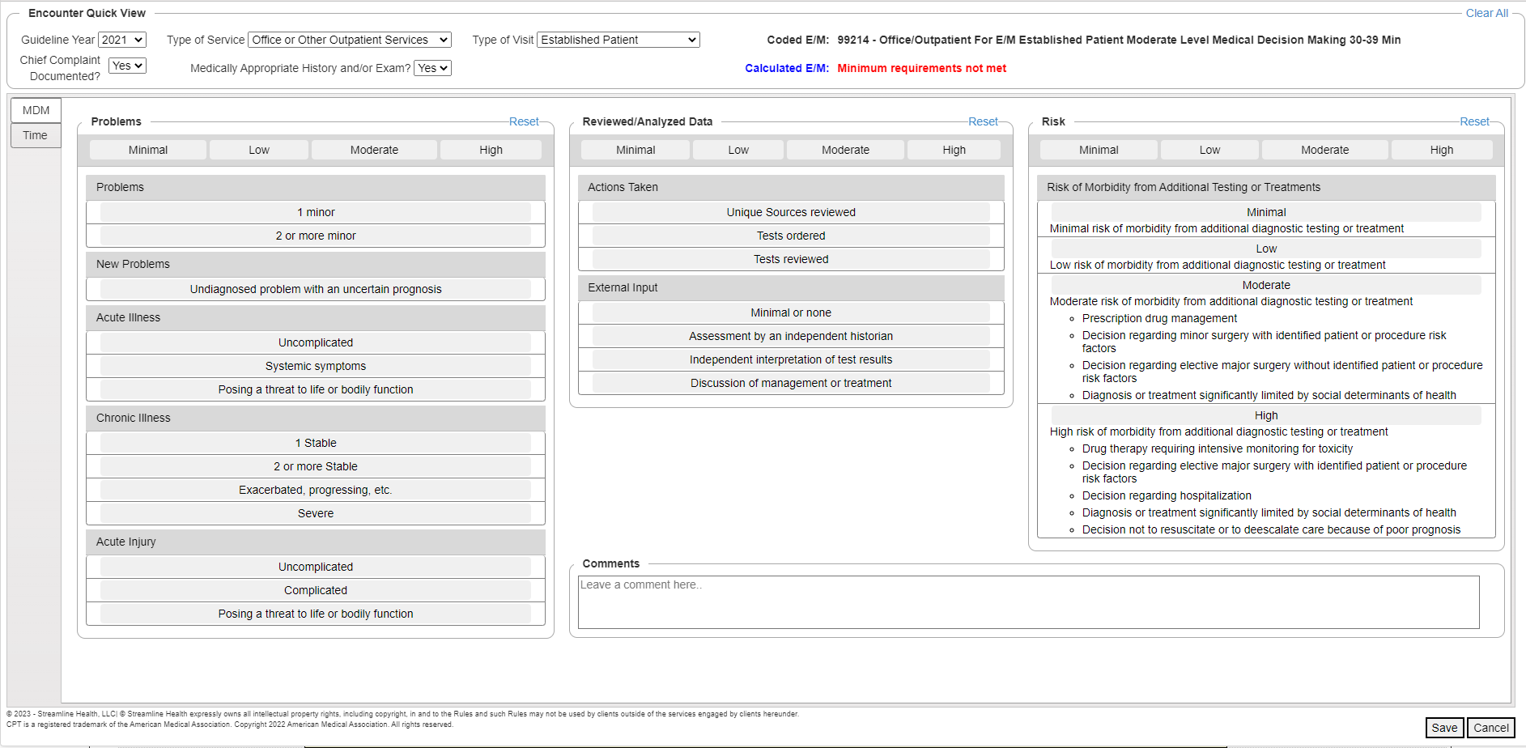
E/M Calculator
The appropriate components for E/M service level calculation will be displayed by clicking the drop down arrows for the following:
  Guideline year
    1995
    1997
    2021
    2023
  Type of service
    Office
    Hospital
    Etc.
  Type of visit
    New
    Established
Notes:
When the E/M calculator icon has been selected, a new window launches to display the E/M calculator. The default guideline year, type of service and type of visit will display based on the reported E/M code and the date of service.
The default value for each can be changed by using the drop-down arrows for each category. The guideline years available are '95, '97, 2021 and 2023. The type of service options available are based on the guideline year that has been selected.

Slide 31
E/M Calculator
Medical Decision Making Elements
The MDM components of the E/M service can be selected:
  Using the Quick select bar at the top of each element
  OR
  Using the individual options listed below each element
Notes:
The Medical Decision Making components can be selected by either using the quick select bar at the top or by using the individual options listed below each element.
As you click on the options, the level of service will be automatically be calculated.

Slide 32
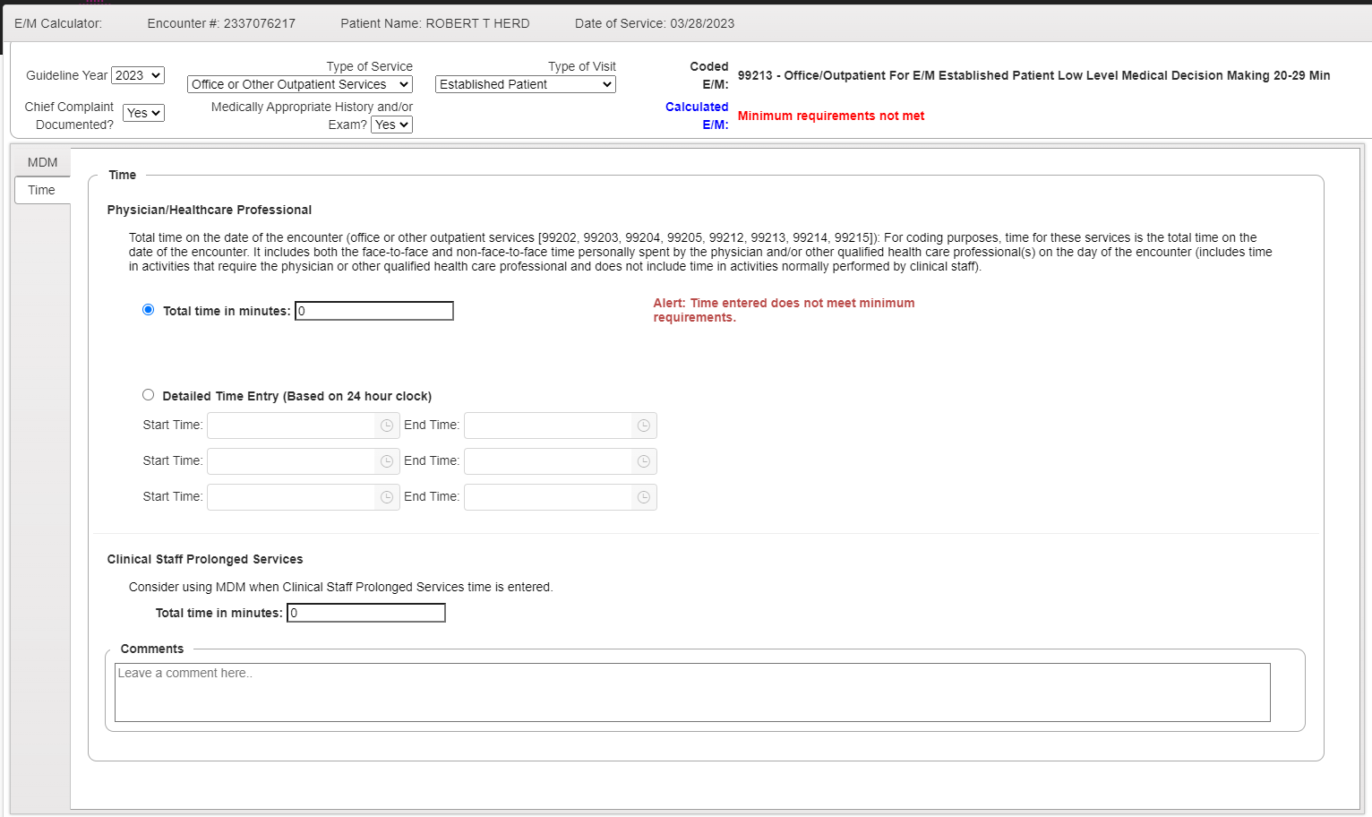
E/M Calculator
Time
To calculate the level of service for a time based encounter
  Select Time on the left hand side of the screen
  Free text the total time or detailed time
Notes:
Time can also be used for calculation by selecting the Time button on the left hand side of the screen. The time can be entered using free text in the total time box. Time can also be entered in the detailed time entry fields.
You can use both the MDM calculator and the time calculator for a single encounter. The highest level of service will be calculated, whether based on time or MDM when using 2021 or 2023 guidelines.
Once the level of service is calculated, you will click on Save at the bottom of the screen. The updated E/M code will populate in the Procedures section on the Audit Detail page.

Slide 33
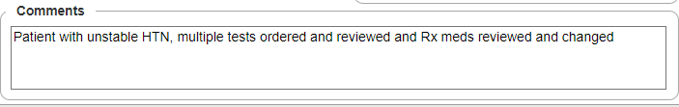
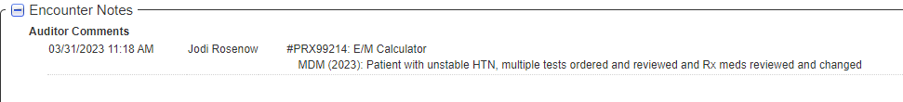
E/M Calculator
Comments
Comments may be made to any Component within the E/M Calculator
  Comments saved in the E/M Calculator display in Encounter Notes on the Audit Details page
Notes:
Comments can be made to the components within the E/M calculator. Any comments saved in the E/M calculator will display in Encounter notes on the audit details page. The comment will be associated with the specific E/M calculator component where the comment was made.
The screenshots on the slide show the difference between a comment that was made using the comment button on the bottom of the Audit Detail page and a comment that was made within the E/M calculator. As you can see on the slide, the comment made within the E/M calculator contains specific information linking that comment to medical decision making.

Slide 34
eValuator Trivia Time!
Look in the Teams meeting chat for URL to access eValuator Trivia

Slide 35
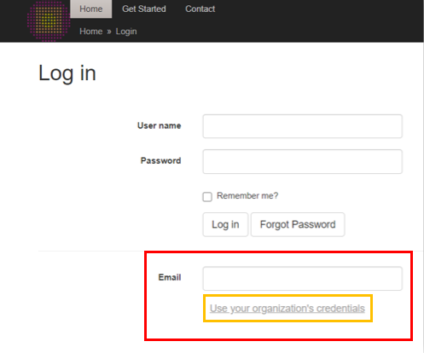
Heading
Subheading
https://uat-evaluator.streamlinehealth.net/Account/Login
Sign-in using your Organization’s email and click “Use Your Organization’s Credentials”

